Slide 1
COURSE TITLE: Operating Systems
UNIT - 2

Slide 2
UNIT 2: Process Management

Slide 3
Process Concept
Process
A process is basically a program in execution. The execution of a process must progress in a sequential fashion.
A process is defined as an entity which represents the basic unit of work to be implemented in the system.
To put it in simple terms, we write our computer programs in a text file and when we execute this program, it becomes a process which performs all the tasks mentioned in the program.

Slide 4
Process Concept
Process
When a program is loaded into the memory and it becomes a process, it can be divided into four sections ─ stack, heap, text and data.
The following image shows a simplified layout of a process inside main memory −

Slide 5
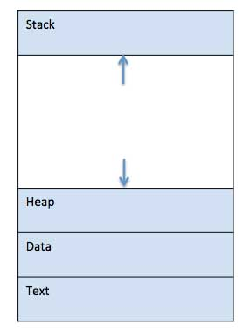
Process Concept
Process

Slide 6
Process Concept
S.N. | Component & Description
1 | Stack The process Stack contains the temporary data such as method/function parameters, return address and local variables.
2 | Heap This is dynamically allocated memory to a process during its run time.
3 | Text This includes the current activity represented by the value of Program Counter and the contents of the processor's registers.
4 | Data This section contains the global and static variables.

Slide 7
Process Concept
Process Life Cycle
When a process executes, it passes through different states. These stages may differ in different operating systems, and the names of these states are also not standardized.
In general, a process can have one of the following five states at a time.

Slide 8
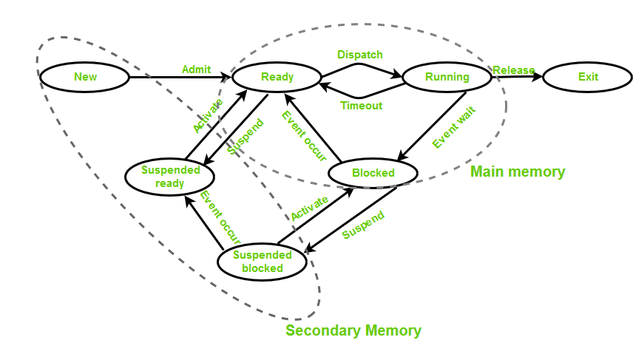
Process Concept
Process Life Cycle

Slide 9
Process Concept
Process States in Operating System
The states of a process are as follows:
New (Create): In this step, the process is about to be created but not yet created. It is the program that is present in secondary memory that will be picked up by OS to create the process.
Ready: New -> Ready to run. After the creation of a process, the process enters the ready state i.e. the process is loaded into the main memory. The process here is ready to run and is waiting to get the CPU time for its execution. Processes that are ready for execution by the CPU are maintained in a queue called ready queue for ready processes.
Run: The process is chosen from the ready queue by the CPU for execution and the instructions within the process are executed by any one of the available CPU cores.

Slide 10
Process Concept
Blocked or Wait: Whenever the process requests access to I/O or needs input from the user or needs access to a critical region(the lock for which is already acquired) it enters the blocked or waits for the state. The process continues to wait in the main memory and does not require CPU. Once the I/O operation is completed the process goes to the ready state.
Terminated or Completed: Process is killed as well as PCB is deleted. The resources allocated to the process will be released or deallocated.
Suspend Ready: Process that was initially in the ready state but was swapped out of main memory and placed onto external storage by the scheduler is said to be in suspend ready state. The process will transition back to a ready state whenever the process is again brought onto the main memory.

Slide 11
Process Concept
Suspend wait or suspend blocked: Similar to suspend ready but uses the process which was performing I/O operation and lack of main memory caused them to move to secondary memory. When work is finished it may go to suspend ready.

Slide 12
Process Concept
Process Control Block (PCB)
A Process Control Block is a data structure maintained by the Operating System for every process.
The PCB is identified by an integer process ID (PID).
A PCB keeps all the information needed to keep track of a process as listed below in the table −

Slide 13
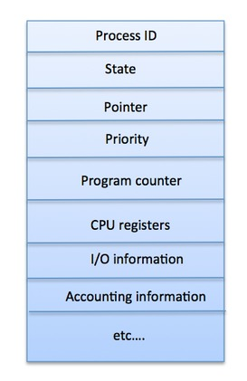
Process Concept
Process Control Block (PCB)

Slide 14
Process Concept
S.N. | Information & Description
1 | Process State The current state of the process i.e., whether it is ready, running, waiting, or whatever.
2 | Process privileges This is required to allow/disallow access to system resources.
3 | Process ID Unique identification for each of the process in the operating system.
4 | Pointer A pointer to parent process.
5 | Program Counter Program Counter is a pointer to the address of the next instruction to be executed for this process.
6 | CPU registers Various CPU registers where process need to be stored for execution for running state.
7 | CPU Scheduling Information Process priority and other scheduling information which is required to schedule the process.
8 | Memory management information This includes the information of page table, memory limits, Segment table depending on memory used by the operating system.
9 | Accounting information This includes the amount of CPU used for process execution, time limits, execution ID etc.
10 | IO status information This includes a list of I/O devices allocated to the process.

Slide 15
Process Concept
Types of Schedulers
Long-term – performance: Decides how many processes should be made to stay in the ready state. This decides the degree of multiprogramming. Once a decision is taken it lasts for a long time which also indicates that it runs infrequently. Hence it is called a long-term scheduler.
Short-term – Context switching time: Short-term scheduler will decide which process is to be executed next and then it will call the dispatcher. A dispatcher is a software that moves the process from ready to run and vice versa. In other words, it is context switching. It runs frequently. Short-term scheduler is also called CPU scheduler.

Slide 16
Process Concept
Types of Schedulers
Medium-term – Swapping time: Suspension decision is taken by the medium-term scheduler. The medium-term scheduler is used for swapping which is moving the process from main memory to secondary and vice versa. The swapping is done to reduce degree of multiprogramming.

Slide 17
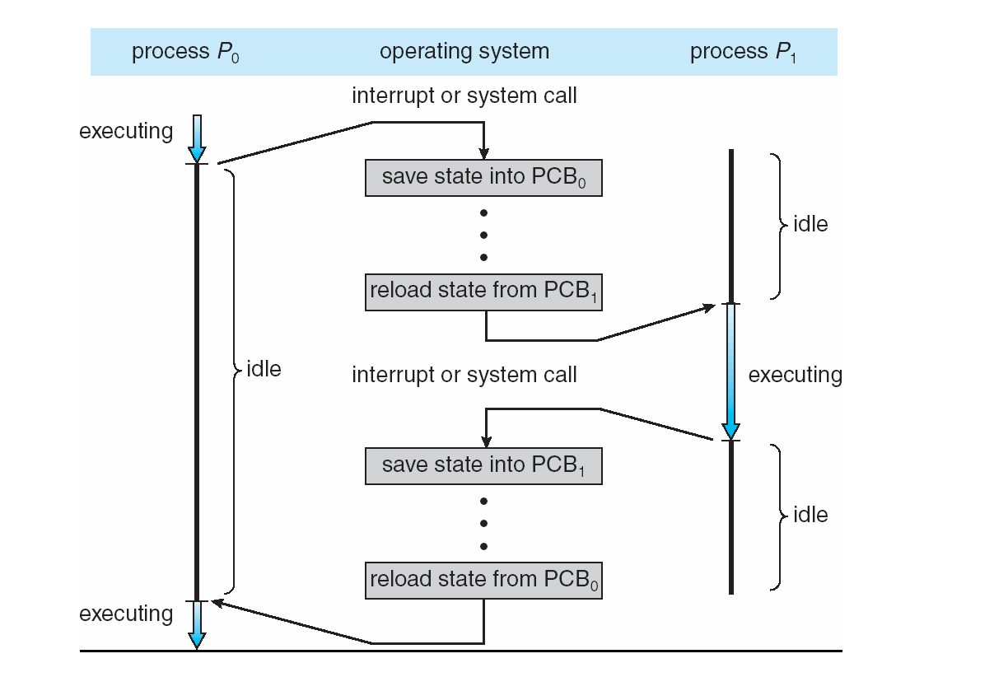
CPU Switch From Process to Process

Slide 18
Process Scheduling
Maximize CPU use, quickly switch processes onto CPU for time sharing
Process scheduler selects among available processes for next execution on CPU
Maintains scheduling queues of processes
Job queue – set of all processes in the system
Ready queue – set of all processes residing in main memory, ready and waiting to execute
Device queues – set of processes waiting for an I/O device
Processes migrate among the various queues

Slide 19
Context Switch
When CPU switches to another process, the system must save the state of the old process and load the saved state for the new process via a context switch
Context of a process represented in the PCB
Context-switch time is overhead; the system does no useful work while switching
The more complex the OS and the PCB ➔ the longer the context switch
Time dependent on hardware support
Some hardware provides multiple sets of registers per CPU ➔ multiple contexts loaded at once

Slide 20
Process Creation
Parent process create children processes, which, in turn create other processes, forming a tree of processes
Generally, process identified and managed via a process identifier (pid)
Resource sharing options
Parent and children share all resources
Children share subset of parent’s resources
Parent and child share no resources
Execution options
Parent and children execute concurrently
Parent waits until children terminate

Slide 21
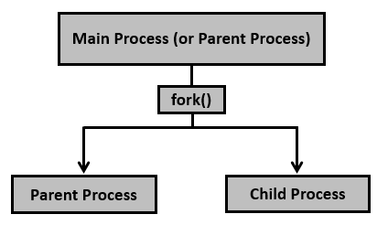
Process creation
Process creation is achieved through the fork() system call.
The newly created process is called the child process and the process that initiated it (or the process when execution is started) is called the parent process.
After the fork() system call, now we have two processes - parent and child processes. How to differentiate them? Very simple, it is through their return values.

Slide 22
Process creation
The fork() system call returns either of the three values −
Negative value to indicate an error, i.e., unsuccessful in creating the child process.
Returns a zero for child process.
Returns a positive value for the parent process. This value is the process ID of the newly created child process.

Slide 23
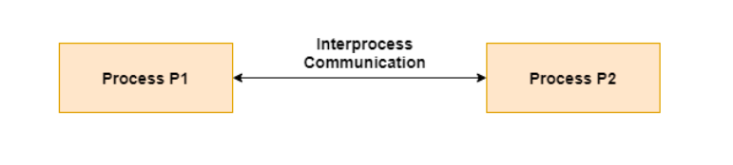
Inter process communication
Interprocess communication is the mechanism provided by the operating system that allows processes to communicate with each other.
This communication could involve a process letting another process know that some event has occurred or the transferring of data from one process to another.

Slide 24
Inter process communication
A process can be of two types:
Independent process.
Co-operating process.

Slide 25
Inter process communication
An independent process is not affected by the execution of other processes while a co-operating process can be affected by other executing processes.
Though one can think that those processes, which are running independently, will execute very efficiently, in reality, there are many situations when co-operative nature can be utilized for increasing computational speed, convenience, and modularity.
Inter-process communication (IPC) is a mechanism that allows processes to communicate with each other and synchronize their actions.
The communication between these processes can be seen as a method of co-operation between them.

Slide 26
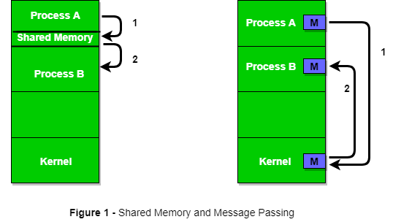
Inter process communication
Processes can communicate with each other through both:
Shared Memory
Message passing

Slide 27
Inter process communication
i) Shared Memory Method
Ex: Producer-Consumer problem
There are two processes: Producer and Consumer.
The producer produces some items and the Consumer consumes that item.
The two processes share a common space or memory location known as a buffer where the item produced by the Producer is stored and from which the Consumer consumes the item if needed.

Slide 28
Inter process communication
Let's understand what is the problem?
Below are a few points that considered as the problems occur in Producer-Consumer:
The producer should produce data only when the buffer is not full. In case it is found that the buffer is full, the producer is not allowed to store any data into the memory buffer.
Data can only be consumed by the consumer if and only if the memory buffer is not empty. In case it is found that the buffer is empty, the consumer is not allowed to use any data from the memory buffer.
Accessing memory buffer should not be allowed to producer and consumer at the same time.

Slide 29
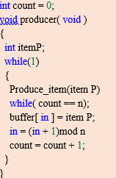
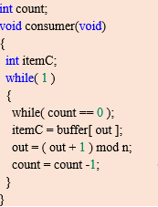
Inter process communication
Producer Code Consumer Code

Slide 30
Inter process communication
"in" used in a producer code represent the next empty buffer
"out" used in consumer code represent first filled buffer
count keeps the count number of elements in the buffer

Slide 31
Inter process communication
ii) Messaging Passing Method
Now, we will start our discussion of the communication between processes via message passing. In this method, processes communicate with each other without using any kind of shared memory. If two processes p1 and p2 want to communicate with each other, they proceed as follows:
Establish a communication link (if a link already exists, no need to establish it again.)
Start exchanging messages using basic primitives.
We need at least two primitives:
– send(message, destination) or send(message)
– receive(message, host) or receive(message)

Slide 32
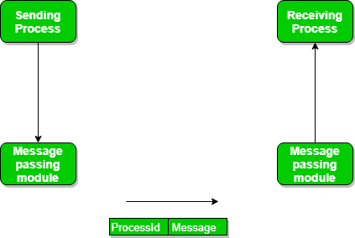
Inter process communication
ii) Messaging Passing Method

Slide 33
Inter process communication
ii) Messaging Passing Method
Message Passing through Communication Link.
Message Passing through Exchanging the Messages.
Communication in client/server Architecture

Slide 34
Inter process communication
Inter Process Communication – Pipes
Pipe is a communication medium between two or more related or interrelated processes. It can be either within one process or a communication between the child and the parent processes.
Communication can also be multi-level such as communication between the parent, the child and the grand-child, etc.
Communication is achieved by one process writing into the pipe and other reading from the pipe.
To achieve the pipe system call, create two files, one to write into the file and another to read from the file.

Slide 35
Inter process communication
Inter Process Communication – Pipes
Conceptually, a pipe is a connection between two processes, such that the standard output from one process becomes the standard input of the other process. In UNIX Operating System, Pipes are useful for communication between related processes(inter-process communication).
Pipe is one-way communication only i.e we can use a pipe such that One process write to the pipe, and the other process reads from the pipe. It opens a pipe, which is an area of main memory that is treated as a “virtual file”.
The pipe can be used by the creating process, as well as all its child processes, for reading and writing. One process can write to this “virtual file” or pipe and another related process can read from it.

Slide 36
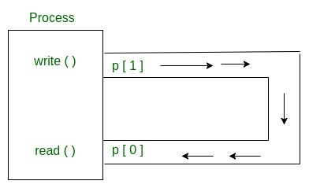
Inter process communication
Inter Process Communication – Pipes

Slide 37
Inter process communication
Inter Process Communication – Pipes
Parent and child sharing a pipe
When we use fork in any process, file descriptors remain open across child process and also parent process. If we call fork after creating a pipe, then the parent and child can communicate via the pipe.

Slide 38
Inter process communication
Inter Process Communication – Pipes
A pipe works on the first in, first out principle and behaves like a queue data structure. With a pipe, the output of the first process becomes the input of the second.
However, the reverse does not happen. This is why a pipe is a form of one-way communication between processes or commands.
For two-way communication, two pipes can be set up, one for each direction.

Slide 39
Process Synchronization
Process Synchronization is the coordination of execution of multiple processes in a multi-process system to ensure that they access shared resources in a controlled and predictable manner.
It aims to resolve the problem of race conditions and other synchronization issues in a concurrent system.
The main objective of process synchronization is to ensure that multiple processes access shared resources without interfering with each other, and to prevent the possibility of inconsistent data due to concurrent access.

Slide 40
Process Synchronization
On the basis of synchronization, processes are categorized as one of the following two types:
Independent Process: The execution of one process does not affect the execution of other processes.
Cooperative Process: A process that can affect or be affected by other processes executing in the system.
Process synchronization problem arises in the case of Cooperative process also because resources are shared in Cooperative processes.

Slide 41
Process Synchronization
Race Condition
A Race Condition typically occurs when two or more threads try to read, write and possibly make the decisions based on the memory that they are accessing concurrently.
When more than one process is executing the same code or accessing the same memory or any shared variable in that condition there is a possibility that the output or the value of the shared variable is wrong so for that all the processes doing the race to say that my output is correct this condition known as a race condition.

Slide 42
Process Synchronization
Race Condition
A race condition is a situation that may occur inside a critical section.
This happens when the result of multiple thread execution in the critical section differs according to the order in which the threads execute.
Race conditions in critical sections can be avoided if the critical section is treated as an atomic instruction.

Slide 43
Process Synchronization
A simple example of a race condition is a light switch. In some homes, there are multiple light switches connected to a common ceiling light.
When these types of circuits are used, the switch position becomes irrelevant. If the light is on, moving either switch from its current position turns the light off.
Similarly, if the light is off, then moving either switch from its current position turns the light on.

Slide 44
Process Synchronization
In computer memory or storage, a race condition may occur if commands to read and write a large amount of data are received at almost the same instant, and the machine attempts to overwrite some or all of the old data while that old data is still being read. The result may be one or more of the following:
the computer crashes or identifies an illegal operation of the program
errors reading the old data
errors writing the new data

Slide 45
Process Synchronization
Critical Section Problem:
A critical section is a code segment that can be accessed by only one process at a time.
The critical section contains shared variables that need to be synchronized to maintain the consistency of data variables.
So the critical section problem means designing a way for cooperative processes to access shared resources without creating data inconsistencies.

Slide 46
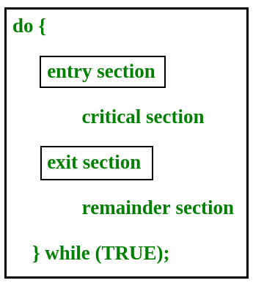
Process Synchronization
Critical Section Problem:

Slide 47
Process Synchronization
Critical Section Problem:
In the entry section, the process requests for entry in the Critical Section.
Any solution to the critical section problem must satisfy three requirements:
1. Mutual Exclusion: If a process is executing in its critical section, then no other process is allowed to execute in the critical section.

Slide 48
Process Synchronization
Critical Section Problem:
2. Progress: If no process is still in the critical section and other processes are waiting outside the critical section to execute, then any one of the threads must be permitted to enter the critical section.
The decision of which process will enter the critical section will be taken by only those processes that are not executing in the remaining section.

Slide 49
Process Synchronization
Critical Section Problem:
3. Bounded Waiting (No starvation): Starvation means a process keeps waiting forever to access the critical section but never gets a chance. No starvation is also known as Bounded Waiting.
A process should not wait forever to enter inside the critical section.
When a process submits a request to access its critical section, there should be a limit or bound, which is the number of other processes that are allowed to access the critical section before it.
After this bound is reached, this process should be allowed to access the critical section.

Slide 50
Peterson’s Algorithm in Process Synchronization
Good algorithmic description of solving the problem
Two process solution
Assume that the load and store machine-language instructions are atomic; that is, cannot be interrupted
The two processes share two variables:
int turn;
Boolean flag[2]
The variable turn indicates whose turn it is to enter the critical section
The flag array is used to indicate if a process is ready to enter the critical section. flag[i] = true implies that process Pi is ready!

Slide 51
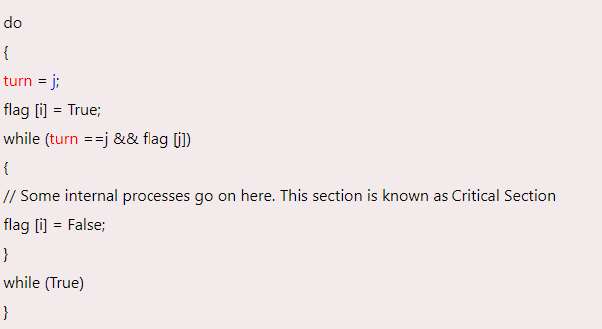
Peterson’s Algorithm in Process Synchronization

Slide 52
Peterson’s Algorithm in Process Synchronization
Provable that the three CS requirement are met:
1. Mutual exclusion is preserved
Pi enters CS only if:
either flag[j] = false or turn = i
2. Progress requirement is satisfied
3. Bounded-waiting requirement is met

Slide 53
Sleep and Wake
Sleep (Blocking) in Critical Section:
When multiple processes/threads need to access a shared critical section, it's essential to ensure that only one process/thread is inside the critical section at a time.
In other words, the process/thread realizes that it cannot enter the critical section immediately because it's currently being used by another process/thread.
So, instead of continuously checking if the critical section is available (which would be inefficient and waste CPU resources), the process/thread enters a sleep state. This frees up the CPU for other processes/threads to execute.

Slide 54
Sleep and Wake
Wakeup (Unblocking) in Critical Section:
When the process/thread inside the critical section finishes its work and exits the critical section, it triggers a "wakeup" mechanism.
This mechanism notifies one of the blocked processes/threads that were waiting to enter the critical section. The awakened process/thread can then proceed to enter the critical section and execute its code.

Slide 55
Semaphores in Operating System
Semaphores are integer variables that are used to solve the critical section problem by using two atomic operations, wait and signal that are used for process synchronization.
The definitions of wait and signal are as follows −
Wait
The wait operation decrements the value of its argument S, if it is positive. If S is negative or zero, then no operation is performed.
wait(S)
{
while (S<=0);
S--;
}

Slide 56
Semaphores in Operating System
Signal
The signal operation increments the value of its argument S.
signal(S)
{
S++;
}

Slide 57
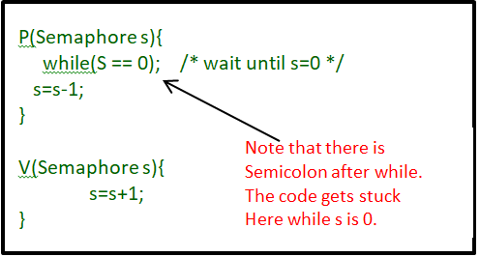
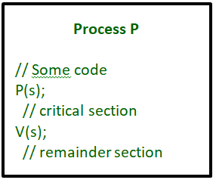
Semaphores in Operating System

Slide 58
Semaphores in Operating System
Types of Semaphores
Binary Semaphore –
This is also known as a mutex lock. It can have only two values – 0 and 1. Its value is initialized to 1. It is used to implement the solution of critical section problems with multiple processes.
Counting Semaphore –
Its value can range over an unrestricted domain. It is used to control access to a resource that has multiple instances.

Slide 59
Semaphores in Operating System
What Is Busy Waiting?
Busy waiting, also known as spinning, or busy looping is a process synchronization technique in which a process/task waits and constantly checks for a condition to be satisfied before proceeding with its execution.
In busy waiting, a process executes instructions that test for the entry condition to be true, such as the availability of a lock or resource in the computer system.

Slide 60
Event counter
An event counter, also known as a semaphore or a counting semaphore, is a synchronization primitive used in operating systems to control access to shared resources among multiple processes or threads.
Event counters provide a way to manage concurrency and ensure that certain sections of code or resources are accessed by a limited number of processes/threads at a time.
Here's how an event counter works:

Slide 61
Event counter
1. Initialization:
An event counter is initialized with a non-negative integer value, often representing the number of available instances of a resource or the number of processes/threads that can access a critical section simultaneously.
2. Operations:
Event counters typically support two primary operations:
Wait (P or Down Operation):
When a process/thread wants to access a resource or a critical section, it first attempts to decrement the event counter. If the counter is greater than zero, the decrement operation proceeds, and the process/thread continues its execution.

Slide 62
Event counter
2. Operations:
Event counters typically support two primary operations:
Signal (V or Up Operation):
When a process/thread finishes using a resource or exits a critical section, it increments the event counter by one.
If there were other processes/threads waiting due to the counter being zero, the signal operation allows one of those processes/threads to proceed, effectively unblocking it and allowing it to access the resource or critical section.

Slide 63
Event counter
Event counters are particularly useful for scenarios where a fixed number of instances of a resource are available or where you want to limit the number of concurrent accesses to a certain section of code.

Slide 64
Monitors in Process Synchronization
Monitors are a synchronization tool used in process synchronization to manage access to shared resources and coordinate the actions of numerous threads or processes.
When opposed to low-level primitives like locks or semaphores, they offer a higher-level abstraction for managing concurrency.
What are Monitors?
A synchronization technique called a monitor unifies operations and data structures into a single entity. They contain both operations that can be carried out on shared resources. By allowing only one thread or process to execute the methods included in the monitor at once, monitors ensure mutual exclusion.

Slide 65
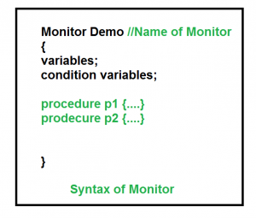
Monitors in Process Synchronization
The monitor is one of the ways to achieve Process synchronization.
It is the collection of condition variables and procedures combined together in a special kind of module or a package.
The processes running outside the monitor can’t access the internal variable of the monitor but can call procedures of the monitor.
Only one process at a time can execute code inside monitors.

Slide 66
Monitors in Process Synchronization
Imagine you're in a classroom, and there's a single computer that everyone wants to use. However, only one person can use it at a time to avoid messing up the work.
Monitors work somewhat like a classroom monitor who ensures that only one student can use the computer at any given time, maintaining order and fairness.

Slide 67
Monitors in Process Synchronization
monitor MyMonitor {
var sharedData: int = 0;
condition myCondition;
procedure myProcedure() {
entry();
sharedData = sharedData + 1;
exit();
}
procedure waitForCondition() {
entry();
wait(myCondition);
exit();
}
procedure signalCondition() {
entry();
signal(myCondition);
exit();
}
}

Slide 68
Threads
Threads are a fundamental concept in operating systems and concurrent programming.
They are the smallest units of execution within a process and allow a program to perform multiple tasks concurrently.
Threads enable efficient multitasking, better resource utilization, and improved responsiveness in modern computer systems.

Slide 69
Threads
Thread Basics:
A process is an executing program with its own memory space, resources, and one or more threads.
A thread is a lightweight unit of execution within a process. Multiple threads within a process share the same memory space and resources.
Multithreading:
Multithreading is the practice of creating multiple threads within a single process.
Threads within the same process can run concurrently, allowing for better utilization of multi-core processors and parallel execution of tasks.

Slide 70
Threads
Types of Threads:
User-level threads: Managed by the user-level thread library. The operating system is unaware of these threads, so thread management is done by the program itself.
Kernel-level threads: Managed by the operating system. Threads are scheduled and managed as part of the operating system's kernel.
Thread States:
Threads can be in various states, including running, ready, blocked, or terminated.
The operating system scheduler manages the transition between these states.

Slide 71
Threads
User-level thread
The operating system does not recognize the user-level thread. User threads can be easily implemented and it is implemented by the user.
If a user performs a user-level thread blocking operation, the whole process is blocked. The kernel level thread does not know nothing about the user level thread.

Slide 72
Threads
Kernel level thread
The kernel thread recognizes the operating system. There is a thread control block and process control block in the system for each thread and process in the kernel-level thread.
The kernel-level thread is implemented by the operating system. The kernel knows about all the threads and manages them.
The kernel-level thread offers a system call to create and manage the threads from user-space. The implementation of kernel threads is more difficult than the user thread. Context switch time is longer in the kernel thread.

Slide 73
Threads
Threads Within the Same Process:
Share: Memory space, code segment, global variables, file descriptors.
Separate: Stack memory, registers, program counter, thread control block.

Slide 74
Threads
Thread Synchronization:
Since threads within a process share resources, proper synchronization mechanisms are needed to prevent race conditions and ensure data consistency.
Synchronization tools like mutexes, semaphores, and condition variables are used to coordinate access to shared resources.

Slide 75
Threads
Each thread has its own Thread Control Block (TCB). Like the process, a context switch occurs for the thread, and register contents are saved in (TCB). As threads share the same address space and resources, synchronization is also required for the various activities of the thread.

Slide 76
Threads
Difference Between Process and Thread
The primary difference is that threads within the same process run in a shared memory space, while processes run in separate memory spaces.
Threads are not independent of one another like processes are, and as a result, threads share with other threads their code section, data section, and OS resources (like open files and signals).
But, like a process, a thread has its own program counter (PC), register set, and stack space.

Slide 77
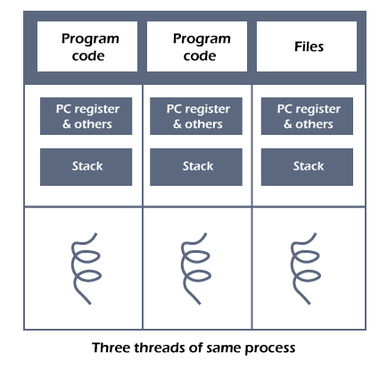
Threads
The process can be split down into so many threads. For example, in a browser, many tabs can be viewed as threads.
MS Word uses many threads - formatting text from one thread, processing input from another thread, etc.

Slide 78
Process scheduling & CPU scheduling
Process Scheduling is the broader concept that encompasses managing all aspects of processes, including I/O operations, memory management, and process execution.
CPU Scheduling is a specific aspect of process scheduling that deals with selecting processes to run on the CPU, aiming to make efficient and optimal use of CPU resources.

Slide 79
Process scheduling & CPU scheduling
Categories of Scheduling
There are two categories of scheduling:
Non-preemptive: Here the resource can’t be taken from a process until the process completes execution. The switching of resources occurs when the running process terminates and moves to a waiting state.
Preemptive: Here the OS allocates the resources to a process for a fixed amount of time. During resource allocation, the process switches from running state to ready state or from waiting state to ready state. This switching occurs as the CPU may give priority to other processes and replace the process with higher priority with the running process.

Slide 80
Process scheduling & CPU scheduling
Objectives of Process Scheduling Algorithm:
Utilization of CPU at maximum level. Keep CPU as busy as possible.
Allocation of CPU should be fair.
Throughput should be Maximum. i.e. Number of processes that complete their execution per time unit should be maximized.
Minimum turnaround time, i.e. time taken by a process to finish execution should be the least.
There should be a minimum waiting time and the process should not starve in the ready queue.
Minimum response time. It means that the time when a process produces the first response should be as less as possible.

Slide 81
Process scheduling & CPU scheduling
There are some popular process scheduling algorithms which we are going to discuss −
First-Come, First-Served (FCFS) Scheduling
Shortest-Job-First (SJF) Scheduling
Priority Scheduling
Round Robin(RR) Scheduling
Multiple-Level Queues Scheduling

Slide 82
Process scheduling & CPU scheduling
FCFS Scheduling-
In FCFS Scheduling,
The process which arrives first in the ready queue is firstly assigned the CPU.
In case of a tie, process with smaller process id is executed first.
It is always non-preemptive in nature.

Slide 83
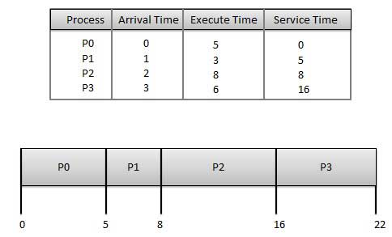
Process scheduling & CPU scheduling
First Come First Serve (FCFS)

Slide 84
Process scheduling & CPU scheduling
First Come First Serve (FCFS)
Wait time of each process is as follows −
Average Wait Time: (0+4+6+13) / 4 = 5.75
Process | Wait Time : Service Time - Arrival Time
P0 | 0 - 0 = 0
P1 | 5 - 1 = 4
P2 | 8 - 2 = 6
P3 | 16 - 3 = 13

Slide 85
Process scheduling & CPU scheduling
Problem:
Consider the set of 3 processes whose arrival time and burst time are given below-
If the CPU scheduling policy is FCFS, calculate the average waiting time and average turn around time.
Process Id | Arrival time | Burst time
P1 | 0 | 2
P2 | 3 | 1
P3 | 5 | 6

Slide 86
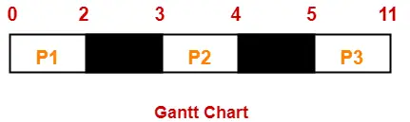
Process scheduling & CPU scheduling
Solution:
Gantt Chart-
Now,
Average Turn Around time = (2 + 1 + 6) / 3 = 9 / 3 = 3 unit
Average waiting time = (0 + 0 + 0) / 3 = 0 / 3 = 0 unit
Process Id | Exit time | Turn Around time | Waiting time
P1 | 2 | 2 – 0 = 2 | 2 – 2 = 0
P2 | 4 | 4 – 3 = 1 | 1 – 1 = 0
P3 | 11 | 11- 5 = 6 | 6 – 6 = 0

Slide 87
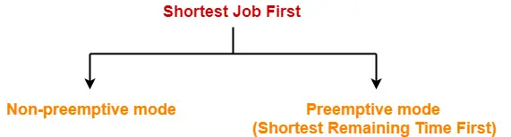
Process scheduling & CPU scheduling
SJF Scheduling-
Out of all the available processes, CPU is assigned to the process having smallest burst time.
In case of a tie, it is broken by FCFS Scheduling.

Slide 88
Process scheduling & CPU scheduling
Advantages-
SRTF (Shortest remaining time first) is optimal and guarantees the minimum average waiting time.
It provides a standard for other algorithms since no other algorithm performs better than it.
Disadvantages-
It can not be implemented practically since burst time of the processes can not be known in advance.
It leads to starvation for processes with larger burst time.
Priorities can not be set for the processes.
Processes with larger burst time have poor response time.

Slide 89
Process scheduling & CPU scheduling
Problem-01: Non-preemptive
Process Id | Arrival time | Burst time
P1 | 3 | 1
P2 | 1 | 4
P3 | 4 | 2
P4 | 0 | 6
P5 | 2 | 3

Slide 90
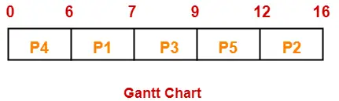
Process scheduling & CPU scheduling
Solution-
Average Turn Around time = (4 + 15 + 5 + 6 + 10) / 5 = 40 / 5 = 8 unit
Average waiting time = (3 + 11 + 3 + 0 + 7) / 5 = 24 / 5 = 4.8 unit
Process Id | Exit time | Turn Around time | Waiting time
P1 | 7 | 7 – 3 = 4 | 4 – 1 = 3
P2 | 16 | 16 – 1 = 15 | 15 – 4 = 11
P3 | 9 | 9 – 4 = 5 | 5 – 2 = 3
P4 | 6 | 6 – 0 = 6 | 6 – 6 = 0
P5 | 12 | 12 – 2 = 10 | 10 – 3 = 7

Slide 91
Process scheduling & CPU scheduling
Problem: If the CPU scheduling policy is SJF preemptive, calculate the average waiting time and average turn around time.
Process Id | Arrival time | Burst time
P1 | 3 | 1
P2 | 1 | 4
P3 | 4 | 2
P4 | 0 | 6
P5 | 2 | 3

Slide 92
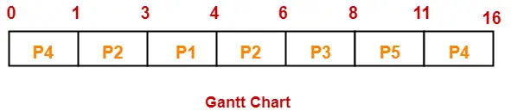
Process scheduling & CPU scheduling
Problem: If the CPU scheduling policy is SJF preemptive, calculate the average waiting time and average turn around time.
Average Turn Around time = (1 + 5 + 4 + 16 + 9) / 5 = 35 / 5 = 7 unit
Average waiting time = (0 + 1 + 2 + 10 + 6) / 5 = 19 / 5 = 3.8 unit

Slide 93
Process scheduling & CPU scheduling
Round Robin Scheduling-
In Round Robin Scheduling,
CPU is assigned to the process on the basis of FCFS for a fixed amount of time.
This fixed amount of time is called as time quantum or time slice.
After the time quantum expires, the running process is preempted and sent to the ready queue.
Then, the processor is assigned to the next arrived process.
It is always preemptive in nature.

Slide 94
Process scheduling & CPU scheduling
Round Robin Scheduling-
Advantages-
It gives the best performance in terms of average response time.
It is best suited for time sharing system, client server architecture and interactive system.

Slide 95
Process scheduling & CPU scheduling
With decreasing value of time quantum,
Number of context switch increases
Response time decreases
Chances of starvation decreases
Thus, smaller value of time quantum is better in terms of response time.
With increasing value of time quantum,
Number of context switch decreases
Response time increases
Chances of starvation increases
Thus, higher value of time quantum is better in terms of number of context switch.

Slide 96
Process scheduling & CPU scheduling
Note:
With increasing value of time quantum, Round Robin Scheduling tends to become FCFS Scheduling.
When time quantum tends to infinity, Round Robin Scheduling becomes FCFS Scheduling.

Slide 97
Process scheduling & CPU scheduling
Problem:
Consider the set of 6 processes whose arrival time and burst time are given below-
If the CPU scheduling policy is Round Robin with time quantum = 4 unit, calculate the average waiting time and average turn around time
Process ID | Arrival Time | Burst Time
1 | 0 | 5
2 | 1 | 6
3 | 2 | 3
4 | 3 | 1
5 | 4 | 5
6 | 6 | 4

Slide 98
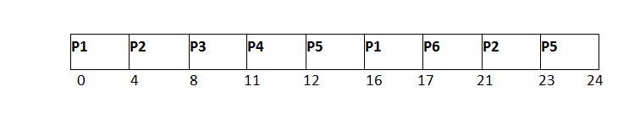
Process scheduling & CPU scheduling
Solution-
Avg Waiting Time = (12+16+6+8+15+11)/6 = 76/6 units

Slide 99
Process scheduling & CPU scheduling
Solution-
Avg Waiting Time = (12+16+6+8+15+11)/6 = 76/6 units

Slide 100
Process scheduling & CPU scheduling
Problem:
Consider the set of 5 processes whose arrival time and burst time are given below-
If the CPU scheduling policy is Round Robin with time quantum = 2 unit, calculate the average waiting time and average turn around time
Process Id | Arrival time | Burst time
P1 | 0 | 5
P2 | 1 | 3
P3 | 2 | 1
P4 | 3 | 2
P5 | 4 | 3

Slide 101
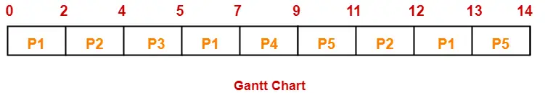
Process scheduling & CPU scheduling
Solution-
Average Turn Around time = (13 + 11 + 3 + 6 + 10) / 5 = 43 / 5 = 8.6 unit
Average waiting time = (8 + 8 + 2 + 4 + 7) / 5 = 29 / 5 = 5.8 unit
Process Id | Exit time | Turn Around time | Waiting time
P1 | 13 | 13 – 0 = 13 | 13 – 5 = 8
P2 | 12 | 12 – 1 = 11 | 11 – 3 = 8
P3 | 5 | 5 – 2 = 3 | 3 – 1 = 2
P4 | 9 | 9 – 3 = 6 | 6 – 2 = 4
P5 | 14 | 14 – 4 = 10 | 10 – 3 = 7

Slide 102
Process scheduling & CPU scheduling
Priority Scheduling-
In Priority Scheduling,
Out of all the available processes, CPU is assigned to the process having the highest priority.
In case of a tie, it is broken by FCFS Scheduling.

Slide 103
Process scheduling & CPU scheduling
A priority number (integer) is associated with each process
The CPU is allocated to the process with the highest priority (smallest integer  highest priority)
Preemptive
Non-preemptive
SJF is priority scheduling where priority is the inverse of predicted next CPU burst time
Problem: Starvation – low priority processes may never execute
Solution: Aging – as time progresses increase the priority of the process

Slide 104
Process scheduling & CPU scheduling
Solutions to Handle Starvation
Some solutions that can be implemented in a system to handle Starvation are as follows:
An independent manager can be used for the allocation of resources. This resource manager distributes resources fairly and tries to avoid Starvation.
Random selection of processes for resource allocation or processor allocation should be avoided as they encourage Starvation.
The priority scheme of resource allocation should include concepts such as Aging, where the priority of a process is increased the longer it waits, which avoids Starvation.

Slide 105
Process scheduling & CPU scheduling
Problem:
Consider the set of 5 processes whose arrival time and burst time are given below-
If the CPU scheduling policy is priority non-preemptive, calculate the average waiting time and average turn around time. (Higher number represents higher priority)
Process Id | Arrival time | Burst time | Priority
P1 | 0 | 4 | 2
P2 | 1 | 3 | 3
P3 | 2 | 1 | 4
P4 | 3 | 5 | 5
P5 | 4 | 2 | 5

Slide 106
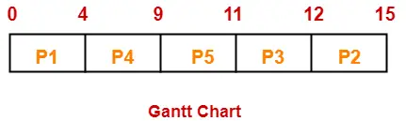
Process scheduling & CPU scheduling
Solution:
Average Turn Around time = (4 + 14 + 10 + 6 + 7) / 5 = 41 / 5 = 8.2 unit
Average waiting time = (0 + 11 + 9 + 1 + 5) / 5 = 26 / 5 = 5.2 unit
Process Id | Exit time | Turn Around time | Waiting time
P1 | 4 | 4 – 0 = 4 | 4 – 4 = 0
P2 | 15 | 15 – 1 = 14 | 14 – 3 = 11
P3 | 12 | 12 – 2 = 10 | 10 – 1 = 9
P4 | 9 | 9 – 3 = 6 | 6 – 5 = 1
P5 | 11 | 11 – 4 = 7 | 7 – 2 = 5

Slide 107
Process scheduling & CPU scheduling
Multilevel Queue Scheduling
Multilevel queue scheduling is a type of CPU scheduling in which the processes in the ready state are divided into different groups, each group having its own scheduling needs.
The ready queue is divided into different queues according to different properties of the process like memory size, process priority, or process type.
All the different processes can be implemented in different ways, i.e., each process queue can have a different scheduling algorithm.

Slide 108
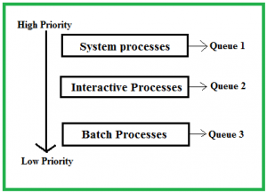
Process scheduling & CPU scheduling
Multilevel Queue Scheduling
Ready Queue is divided into separate queues for each class of processes. For example, let us take three different types of processes System processes, Interactive processes, and Batch Processes. All three processes have their own queue. Now, look at the below figure.

Slide 109
Process scheduling & CPU scheduling
The Description of the processes in the above diagram is as follows:
System Processes: The CPU itself has its own process to run which is generally termed a System Process.
Interactive Processes: An Interactive Process is a type of process in which there should be the same type of interaction.
Batch Processes: Batch processing is generally a technique in the Operating system that collects the programs and data together in the form of a batch before the processing starts.
All three different type of processes have their own queue. Each queue has its own Scheduling algorithm. For example, queue 1 and queue 2 use Round Robin while queue 3 can use FCFS to schedule their processes.

Slide 110
Process scheduling & CPU scheduling
The Description of the processes in the above diagram is as follows:
System Processes: The CPU itself has its own process to run which is generally termed a System Process.
Interactive Processes: An Interactive Process is a type of process in which there should be the same type of interaction.
Batch Processes: Batch processing is generally a technique in the Operating system that collects the programs and data together in the form of a batch before the processing starts.
All three different type of processes have their own queue. Each queue has its own Scheduling algorithm. For example, queue 1 and queue 2 use Round Robin while queue 3 can use FCFS to schedule their processes.

Slide 111

Process scheduling & CPU scheduling
Example Problem:
Priority of queue 1 is greater than queue 2. queue 1 uses Round Robin (Time Quantum = 2) and queue 2 uses FCFS.

Slide 112

Process scheduling & CPU scheduling
Example Problem:
Below is the Gantt chart of the problem:

Slide 113
Process scheduling & CPU scheduling
Two-level scheduling in Operating Systems
Two-level scheduling is an efficient scheduling method that uses two schedulers to perform process scheduling.
Let us understand it by an example :
Suppose a system has 50 running processes all with equal priority and the system’s memory can only hold 10 processes simultaneously. Thus, 40 processes are always swapped out and written on virtual memory on the hard disk. To swap out and swap in a process, it takes 50 ms respectively.

Slide 114
Process scheduling & CPU scheduling
Let us take up the above scenario with straightforward Round-robin scheduling: a process would need to be swapped in (least recently used processes are swapped in) every time when a context switch occurs. Swapping in and out costs too much, and the unnecessary swaps waste much time of scheduler.
So the solution to the problem is two-level scheduling. There are two different schedulers in two-level scheduling :
1. Lower level scheduler
2. Higher level scheduler

Slide 115
Process scheduling & CPU scheduling
1. Lower level scheduler –
This scheduler selects which process will run from memory.
2. Higher level scheduler –
This scheduler focuses on swapping in and swapping out the processes between hard disk and memory. Swapping takes much time, therefore it does its scheduling much less often. It also swaps out the processes which are running for a long time in memory and are swapped with processes on disk that have not run for a long time.

Slide 116
Process scheduling & CPU scheduling
Guaranteed scheduling
A scheduling algorithm used in multitasking operating systems that guarantees fairness by monitoring the amount of CPU time spent by each user and allocating resources accordingly.
Guaranteed scheduling in an operating system ensures that certain processes or tasks get specific levels of service or performance guarantees. This is critical in real-time systems and other applications where meeting deadlines is essential.

Slide 117
Process scheduling & CPU scheduling
Guaranteed scheduling
Priority-Based Scheduling: Higher-priority tasks are scheduled before lower-priority ones, ensuring important tasks get served first.
Rate Monotonic Scheduling (RMS): Assigns priorities based on task periods, ensuring tasks meet their deadlines.
Earliest Deadline First (EDF): Schedules tasks based on their closest deadlines, but it can be less predictable in some situations compared to RMS.

Slide 118
Process scheduling & CPU scheduling
Guaranteed scheduling
Resource Reservation: Reserves CPU time or other resources for specific tasks in advance, guaranteeing their availability when needed.
Guaranteed Minimum Service: Ensures even low-priority tasks receive a minimum level of service.
Scheduling Analysis: Tests are performed to ensure that tasks can meet their deadlines under the chosen scheduling policy.

